Slide 1

3.2.4 Estimation of Sigma Square
MDSC – 201 – Regression Methods
~ Presented by
K Rohith - 23905

Slide 2
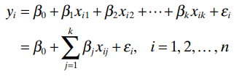
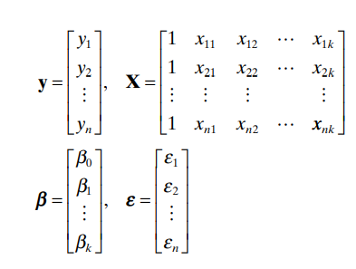
Basic Knowledge
We know the following:
Where :
y is an n × 1 vector of the observations.
X is an n × p matrix of the levels of the regressor variables.
β is a p × 1 vector of the regression coeffi cients.
And ε is an n × 1 vector of random errors.

Slide 3


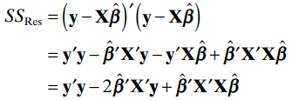
Moving on to the estimation part:
The sum of Squares of residuals is given as
Substituting
we get the following:

Slide 4



Since X X′ = X′y ˆ b , this last equation becomes
The residual sum of squares has n − p degrees of freedom associated with it since p parameters are estimated in the regression model. The residual mean square is
The expected value of MSRes is σ^2 , so an unbiased estimator of σ^2 is given by

Slide 5
Thank You Sairam!

